Slide 1

Bias and fairness are important topics in the deep learning community. To what extent could they affect the development of AI tools in biomedical research?
Group 2
Kelly Cardona Londono
Alejandra Lopez Velazquez
Giulia Sansone

Slide 2
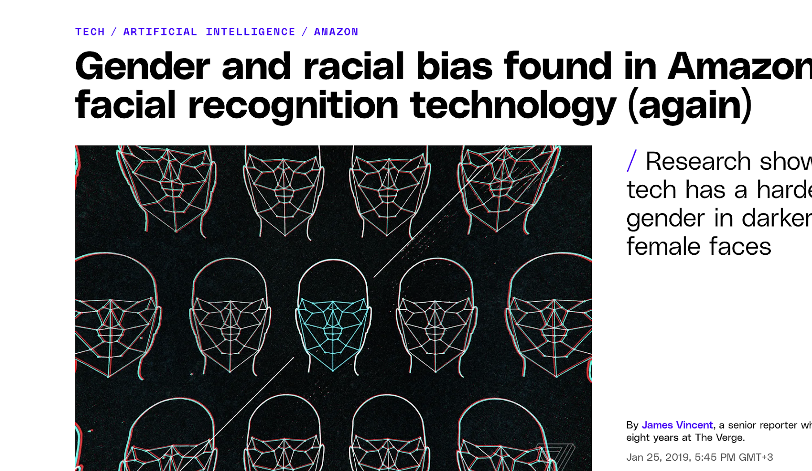
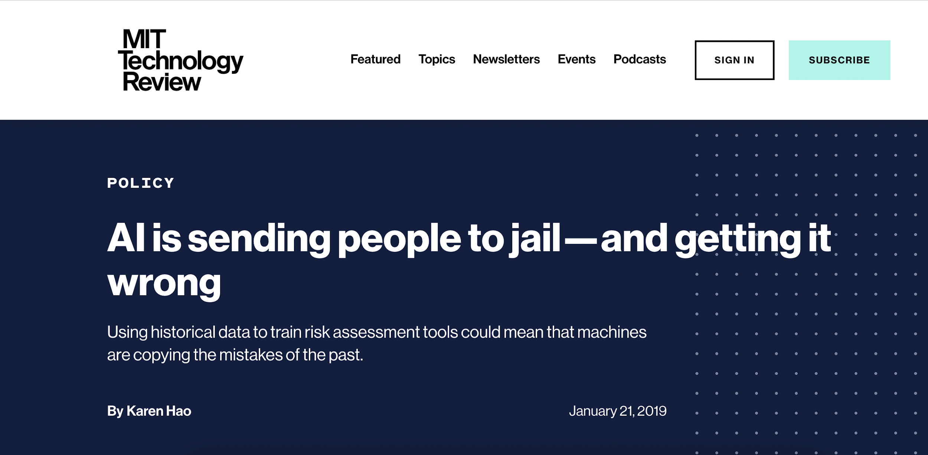
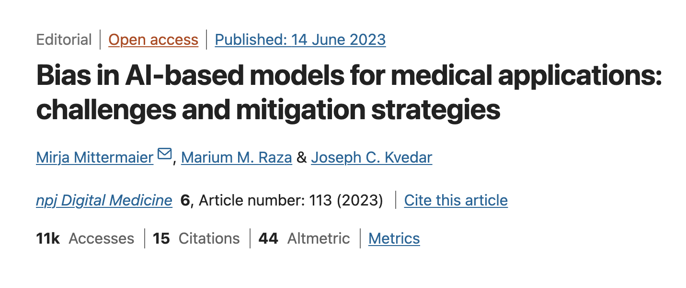

Slide 3

What is a bias?
Bias is defined as a systematic error in decision-making processes that results in unfair outcomes
In the context of AI, bias can arise from various sources, including data collection, algorithm design, and human interpretation

Slide 4
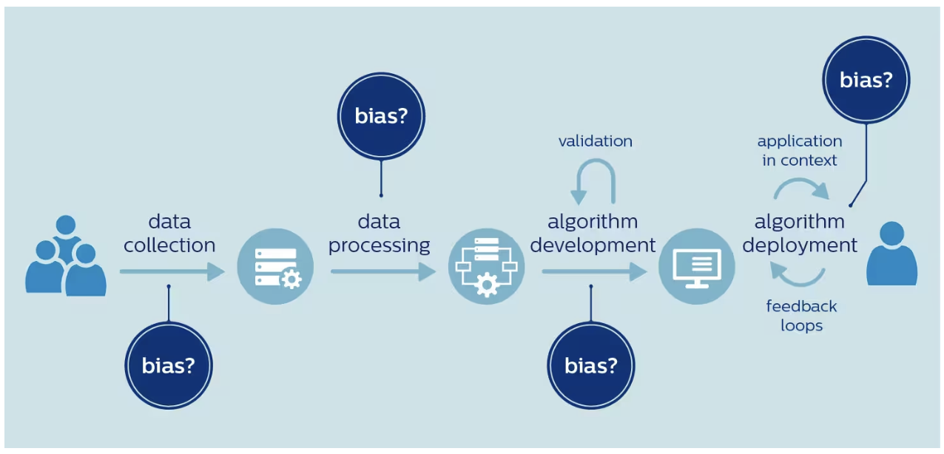
Where do the bias come from?

Slide 5
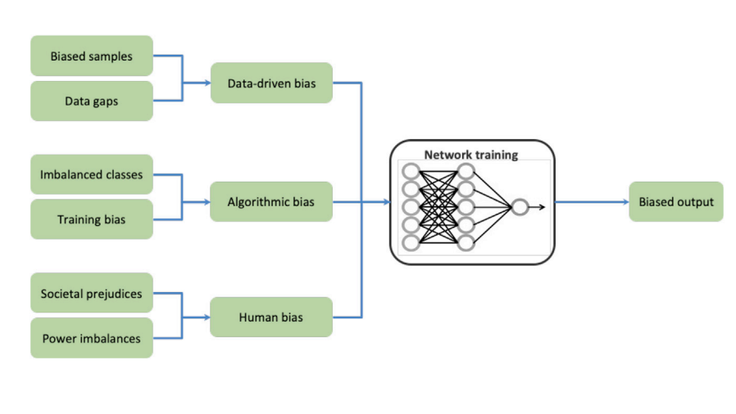
Types of bias
Norori et al., 2021

Slide 6
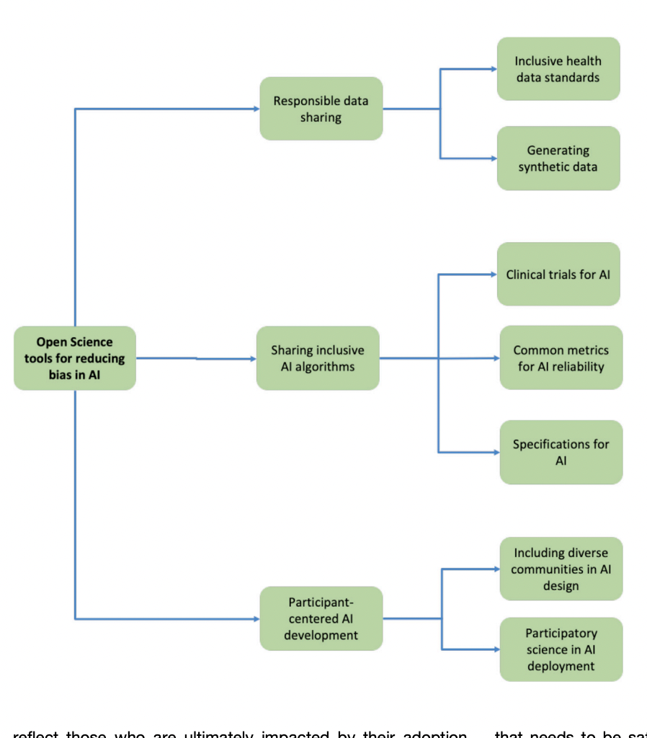
How to overcome AI bias in medical research?
Promote open data sharing
Data standards and interoperability
Generating synthetic data to combat bias
Evaluating algorithmic efficiency and fairness
Explainable AI models
Common metrics for AI reliability
Norori et al., 2021

Slide 7
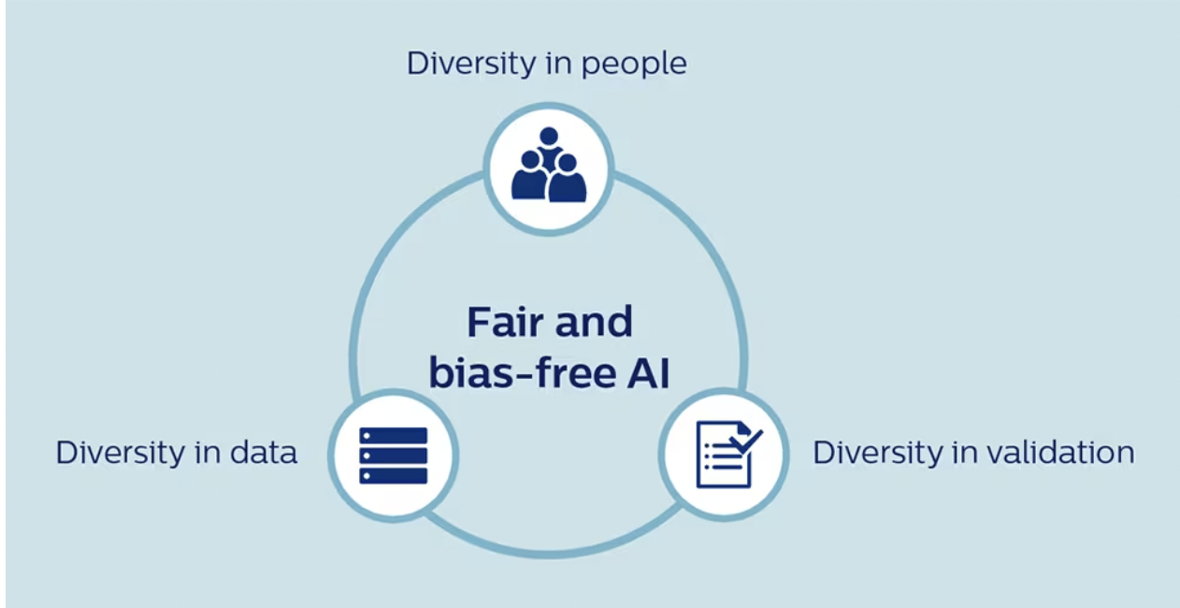

Slide 8

Thank you for your attention!

